Slide 1
Team: SUPER PREDICTION
Yizi(Winnie) Huang YiziwinnieH@hotmail.com
Joshua Smith jsmit301@mail.depaul.edu
Wenyi (Alex) Yan alexyan21@hotmail.com
CSC 575 Final Project (Kaggle) -- Winter 2019
Learning to Rank Home Depot Product Search Relevance

Slide 2

CONTENT
Data Overview
Data Preprocessing
Feature Engineering
Models Generation
Results

Slide 3
DATA OVERVIEW
2 CSVs for product attributes
  Name + Value sets
  Preprocessing needed to collect values by product_id
1 CSV with training data
  Preprocessing needed to connect with aforementioned collected values
1 CSV with test data
  Model validation thus needs to be done via Kaggle or splitting training set

Slide 4
DATA PREPROCESSING
Importation Correction
  Attributes file required slight preprocessing to handle instances where values contained the delimiter (tab)
Spelling Correction
  Utilizes a pre-defined corpus for efficiency (Obtained through Google Search)
  Applied only to search terms
    Assumption made that website data is correctly spelled

Slide 5
DATA PREPROCESSING
Attributes contained names which are useless for relevance calculations
  Example: “Bullet01”
  These were removed
Attributes were then collected together in “name + value” order
String Cleaning
  Applied to ”search_term”, ”product_title”, ”product_description”, and “attribute”
  Removal of useless characters (dashes, period, question marks, etc.)

Slide 6
DATA PREPROCESSING
String Cleaning (Continued)
  Variations in unit representations collected under common identifiers
    Example “inches”, “inch”, “in” = “in.”
  Dimensional identifiers replaced with a unique identifier
    Example: “ x “ and “ * “ = “ xbi ”
  Word representations of numbers replaced with numeric equivalents
    Example: “zero” = 0

Slide 7
STEMMING
Utilized the Snowball Stemmer
  Improved performance over Porter Stemmer
    Porter stemmer originally used for model presented in EC1
  Applied to:
    Search Terms
    Product Titles
    Product Descriptions
    Product Attributes

Slide 8
FEATURE ENGINEERING
Utilization of just frequency counts produced suboptimal results
  What else can be extracted from the dataset?
  Corpus examined for common terms
  Informed decisions through domain knowledge
    Units of Measurement
    Colors
    Brand Names
  Additional metrics which could be applied for further improvements.
    Example: TF-IDF

Slide 9
FEATURE ENGINEERING - TYPES
Common information-related features
2. Extraction of new features from attribute dataset
3. Information combination features
4. Ratio information features
5. Matching exploration features

Slide 10

FEATURE ENGINEERING

Slide 11
FEATURE ENGINEERING
Final Features Added (Continued):
  Number of words which occur in the brand name and respective search terms
  Ratio of terms which are common between the brand and query vs brand name length
  Ratio of terms which are common in the title and the overall length of the query string
  Ratio of terms which are common in the description and the overall length of the query string
  Ratio of terms which are common in the attributes and the overall length of the query string

Slide 12
FEATURE ENGINEERING
Final Features Added (Continued):
  The last word which matched between the title and the query
  The last word which matched between the description and the query
  The first word which matched between the title and the query
  The first word which matched between the description and the query
  The number of common units of measurement between search terms and product_info
  The number of common color terms between search terms and product_info

Slide 13
Query Expansion
Vectorize text features
Using Tf-Idf vectorizer in sklearn
Do Latent Semantic Analysis and achieve query expansion
  The query is expanded using terms which have a similar meaning or bear some relation to those in the query, increasing the chances of matching words in relevant documents.
Use Truncated SVD in sklearn to do LSA
singular value decomposition (SVD) is used to reduce the number of rows while preserving the similarity structure among columns.

Slide 14
MODEL GENERATION
Tried 3 Ensemble models: Random Forest, Gradient Boost, Xgboost
Best model: Gradient Boost Regressor
  Parameter Selection: Grid Search and it's Cross Validation score
  Provides optimal values for:
    Number of Estimators (n_estimators=36)
    Max Depth (max_depth=6)

Slide 15
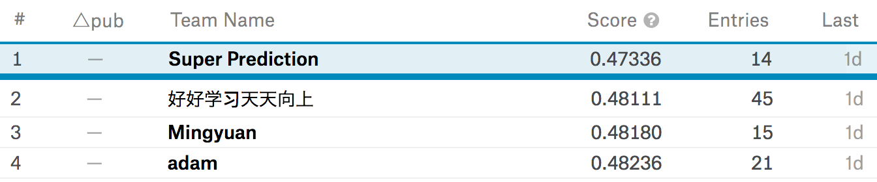
RESULTS
Final (Private) RMSE of 0.47336 obtained
Achieved the best final score in the class competition:

